Slide 1
Python for Quick, Useful Multimedia Manipulation
Tanim Islam, 8 JULY 2020
ONLINE PRESENTATION

Slide 2
Python for Quick, Useful Multimedia Manipulation
Anecdotes from a Python Programmer
tanim.islam@gmail.com
ONLINE PRESENTATION

Slide 3


WHAT THIS TALK IS ABOUT
I make and manipulate lots of images and videos in my day-to-day work.

Slide 4
WHAT THIS TALK IS ABOUT
I show code and demonstrate these things I do all the time.
auto-cropping images.
Videos from a collection of images.
Animated GIFs.
YouTube + song metadata → M4A file.

Slide 5
WHAT THIS TALK IS ABOUT
Functionality comes from three Github repos
GITHUB GIST THAT MAKES MOVIES FROM IMAGES
NPRSTUFF
COVID19_STATS
PLEXSTUFF

Slide 6
AUTOCROPPING IMAGES
Notes:
Why auto-crop images? To remove as much space as possible for images you’ll put into your papers, reports, and other presentations

Slide 7
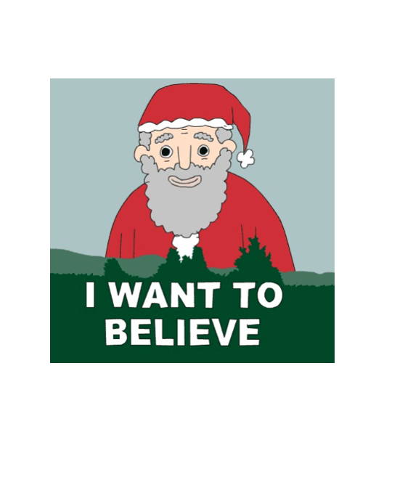

autoCropping lossy (PNG, JPEG, TIFF, etc.) images
First, load image file from the imread function.
imread(…)
Image is stored as a 2D numpy.array of RGBA values.

Slide 8

autoCropping lossy (PNG, JPEG, TIFF, etc.) images
Just find the first and last pixels in X and Y that are NOT white
That is the bounding box. Crop!

Slide 9
AUTOCROPPING PDF images
Uses PyPDF2 and Adobe Ghostscript at a lower level.
Uses Ghostscript to estimate the bounding box.
Crops PDF according to bounding box using PyPDF2.

Slide 10
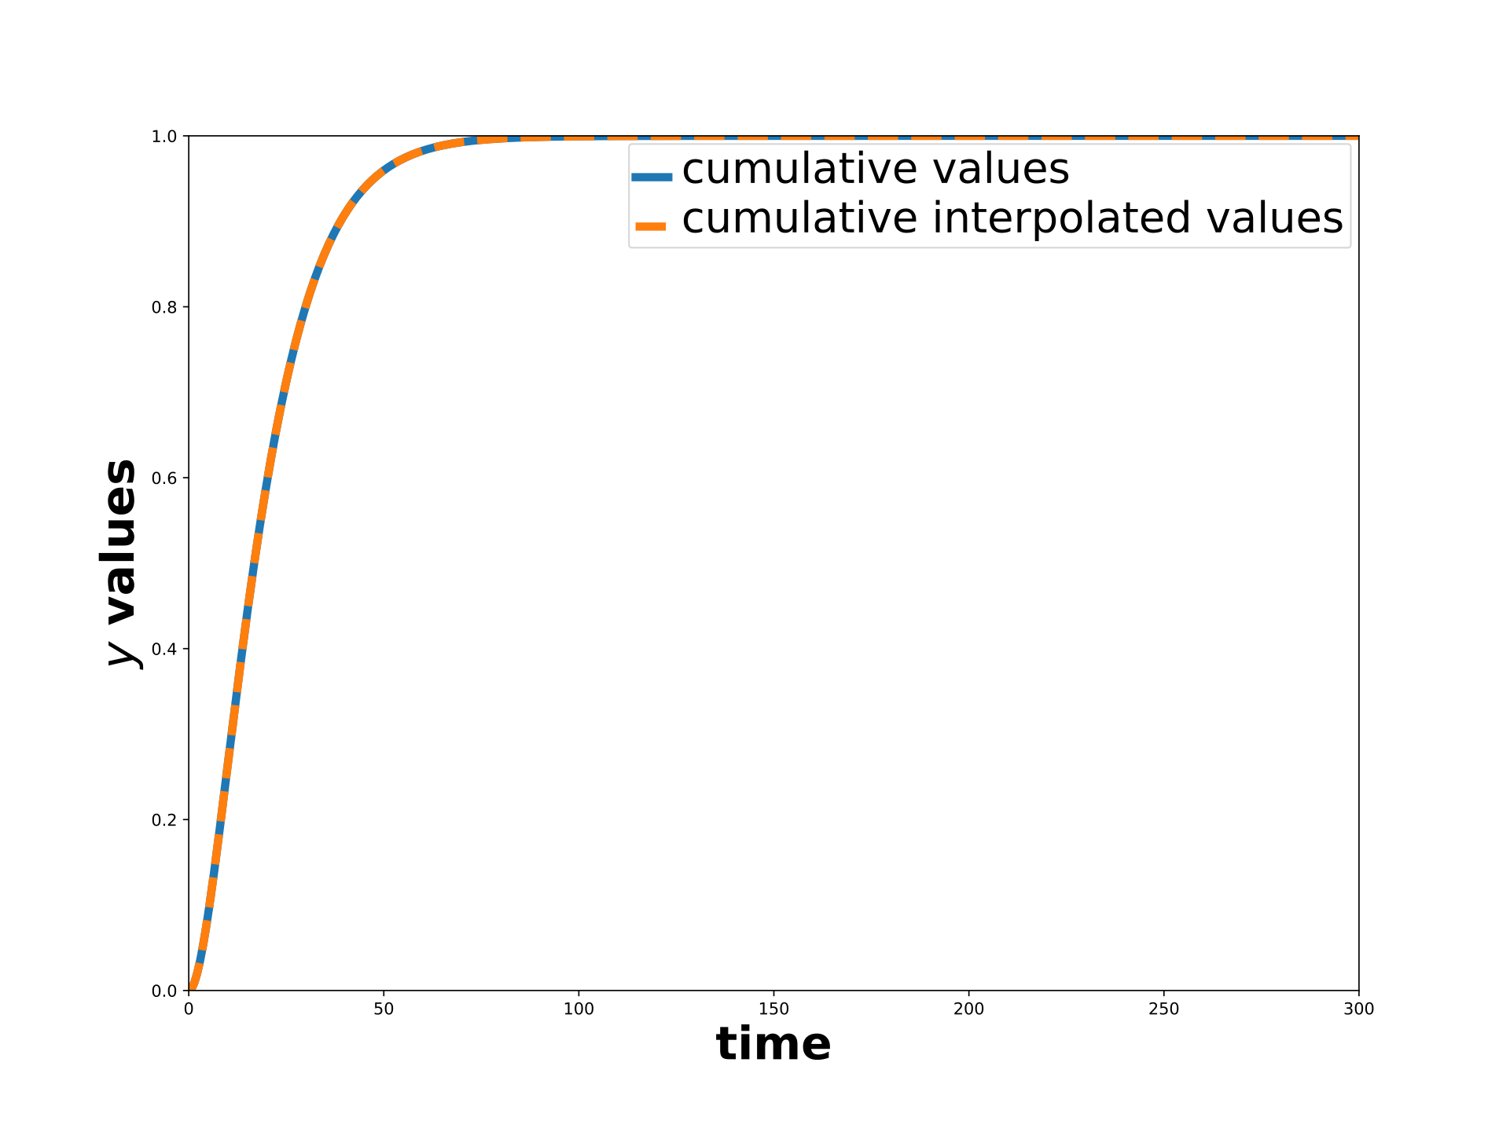
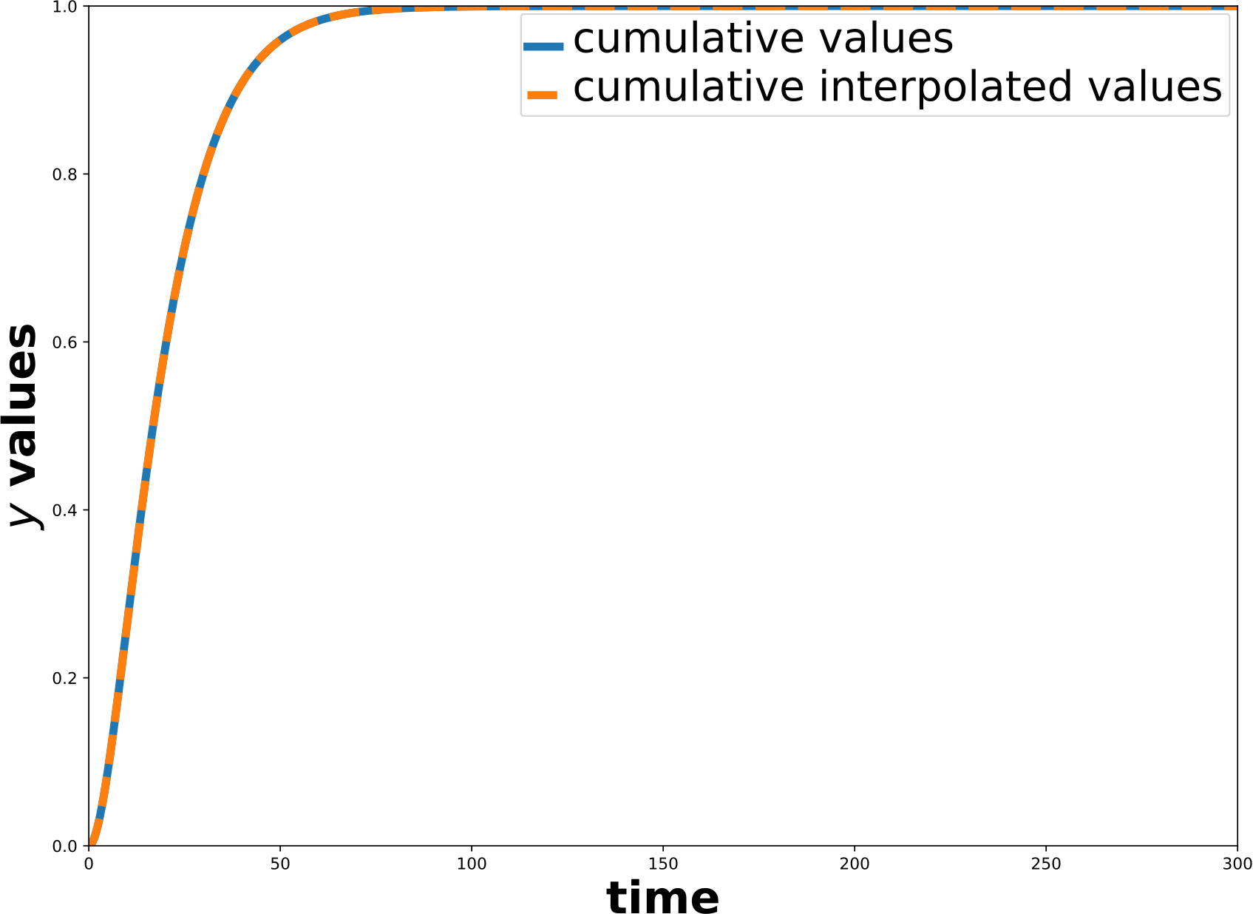
AUTOCROPPING PDF IMAGES
UNCROPPED
AUTOCROPPED

Slide 11
DEMonstration
autoCropImage, from NPRSTUFF Github Repo, automatically crops images.
usage: autoCropImage [-h] --input INPUT [--output OUTPUT] [--color COLOR]
[--trans] [--newwidth NEWWIDTH] [--show]
optional arguments:
-h, --help show this help message and exit
--input INPUT Name of the input file.
--output OUTPUT Name of the output file. Optional.
--color COLOR Name of the color over which to autocrop. Default is
white.
--trans If chosen, also remove the transparency wrapping around
the image. Works only for non-PDF images.
--newwidth NEWWIDTH New width of the image.
--show If chosen, then show the final image after cropped.
Notes:
DEMONSTRATE THIS ON THE PNG: iwanttobelieve_uncropped.png -> iwanttobelieve_cropped.png. DEMONSTRATE THIS ON THE PDF: cumulative_plot_emission.pdf -> cumulative_plot_emission_cropped.pdf
SHOW HOW TO INSTALL TOOL: python3 -m pip install —user git+https://github.com/tanimislam/nprstuff.git#egginfo=nprstuff
Then show the relevant bit of code, in nprstuff/core/autocrop_image.py, that performs the autocropping.

Slide 12
CREATING MOVIES

Slide 13
CREATING MOVIES
One functionality, MP4 movie from a sequence of images, is created for this presentation and as a GitHub Gist.
Other functionality, MP4 movie into animated GIF, uses convertImage’s other functionalities.
Unlike other tools, low-level functionality is handled by FFMPEG (video and audio creation SDK and tools) through subprocess.

Slide 14
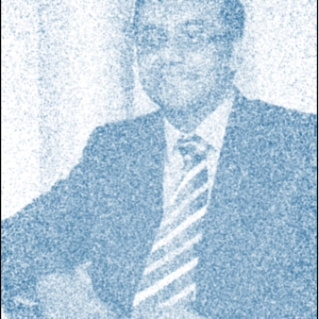
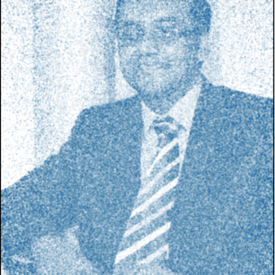
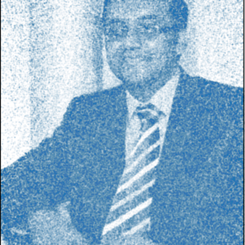
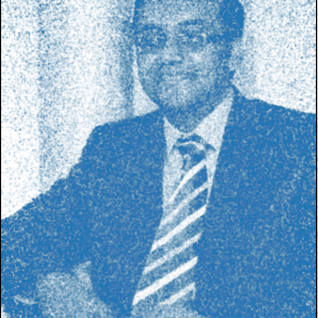
MOVIE FROM IMAGE SEQUENCE
165
195
Python CLI follows this website on creating an MP4 movie from sequence of images.
Image width and height must be divisible by 2.
225
255

Slide 15

DEMONSTRATE MOVIE FROM IMAGE SEQUENCE #1
python3.7 demo_create_movie_sequence.py \
--prefix=img —output=mcmc_images.mp4 \
--dirname="mcmc_animation_images" --fps=10
Notes:
Show the code, and then the command. This is a demonstration of Monte Carlo Markov Chain I gave to some high school students.

Slide 16
DEMONSTRATE MOVIE FROM IMAGE SEQUENCE #2
From the COVID-19 statistics Github repo.
Cumulative COVID-19 cases in CONUS from beginning to 4 JULY 2020.
python3.7 demo_create_movie_sequence.py \
--prefix="covid19_conus_cases_04072020." \
--output="covid19_conus_cases_04072020.mp4" \
--dirname="covid19_conus_cases_04072020_imagefiles" \
--fps=5

Slide 17
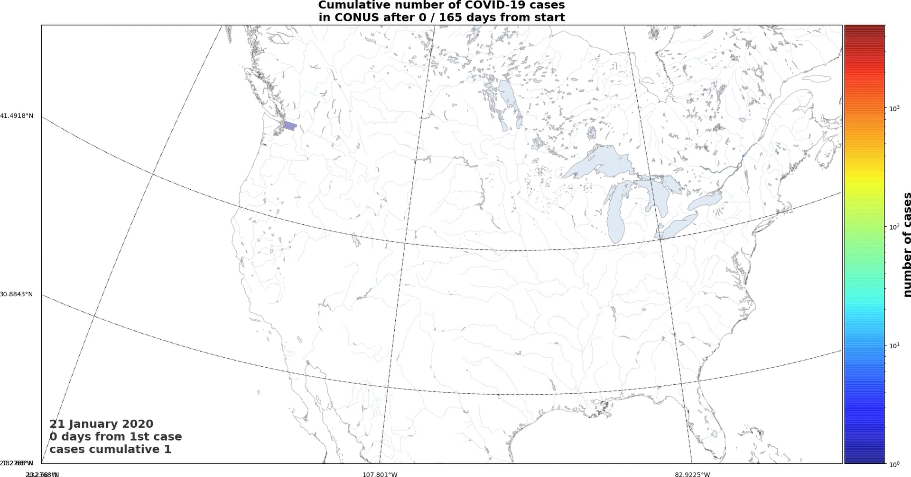
DEMONSTRATE MOVIE FROM IMAGE SEQUENCE #2

Slide 18
animated gif from mp4 or youtube
Why use? Some services (such as GitHub or Read the Docs) do not allow movie files in documentation
They DO allow animated GIFs.
Two-step process creates a GIF from an MP4 file, taken from this website
1st pass creates a high-quality global color palette representative of movie file.
2nd pass converts to animated GIF using 1st pass color palette.
YouTube to GIF (YouTube → MP4 → GIF) uses youtube-dl to download YT clip as MP4.

Slide 19
animated gif from mp4 or youtube
Also uses NPRSTUFF’s convertImage’s other functionalities
usage: convertImage [-h] [--noverify] [--info]
{image,movie,youtube,square} ...
Uses CloudConvert to convert image or video files.
positional arguments:
{image,movie,youtube,square}
Choose whether to convert a video or an image
image If chosen, convert an SVG(Z), PDF, or PNG into PNG.
movie If chosen, convert an MP4 into an animated GIF.
youtube If chosen, convert a YOUTUBE video with URL into an
animated GIF.
square If chosen, create a square MP4 file from an input MP4
file.
optional arguments:
-h, --help show this help message and exit
--noverify If chosen, do not verify the SSL connection.
--info If chosen, then print out INFO level logging.

Slide 20
animated gif from mp4
convertImage movie -f covid19_conus_cases_04072020.mp4
input: 1.8M; output: 32M

Slide 21
animated gif from Youtube
A busy scene from the animated show, Lucas Bros. Moving Co.
convertImage youtube -u "https://www.youtube.com/watch?v=R-pmYwr8zbU" -o "lucas_bros.gif" -q high.
Notes:
SHOW CODE THAT DOES YOUTUBE2GIF AND MP42GIF
DEMONSTRATE CREATION OF THESE TWO ANIMATED GIFs

Slide 22
MAKING MUSIC

Slide 23
I USE plex_music_Songs to download music
METADATA (FROM MUSICBRAINZ)
M4A FILE (WITH ALL METADATA)
AUDIO (FROM YOUTUBE-DL)

Slide 24
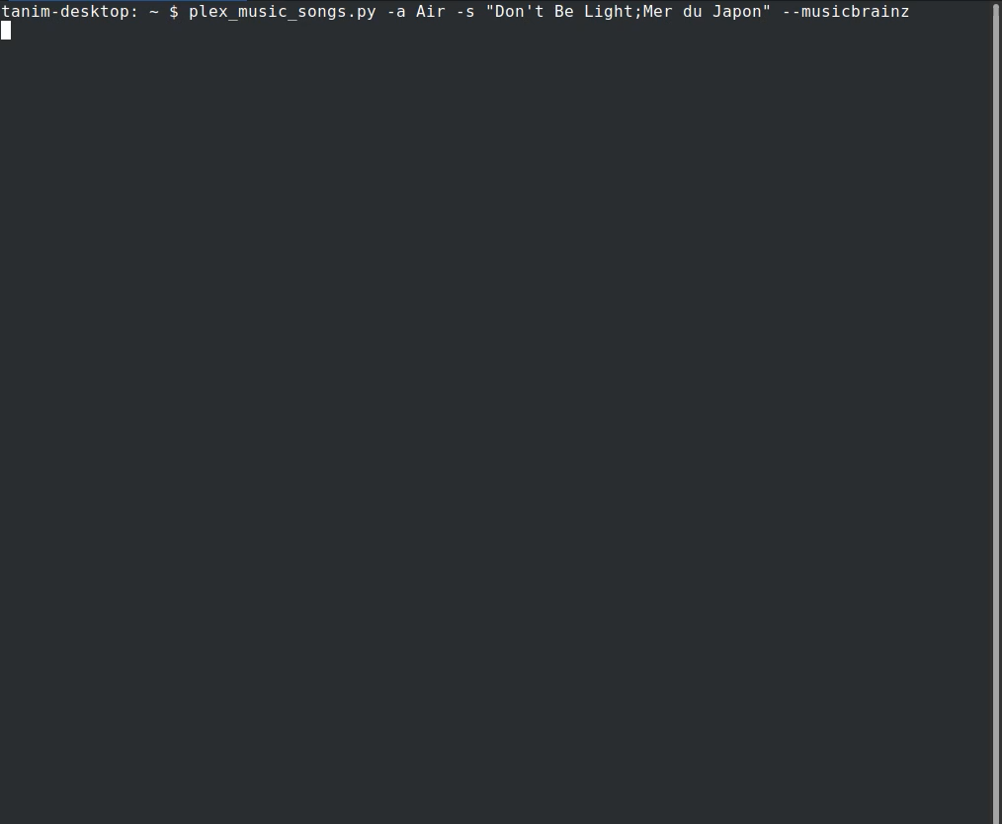
I USE plex_music_Songs to download music
plex_music_songs lives in PLEXSTUFF repository.
Its documentation lives here.
Notes:
SHOW CODE FOR PLEX_MUSIC_SONGS
SHOW CODE THAT GETS THE MUSICBRAINZ METADATA
SHOW CODE THAT TAKES DOWNLOADS YOUTUBE CLIP INTO AN M4A FILE
DO A DEMONSTRATION OF PLEX_MUSIC_SONGS: Air, All I Need

Slide 25
RESOURCES

Slide 26
RESOURCES in this presentation
NPRSTUFF: python3 -m pip install --user git+https://github.com/tanimislam/nprstuff.git#egginfo=nprstuff
PLEXSTUFF: python3 -m pip install --user git+https://github.com/tanimislam/plexstuff.git#egginfo=plexstuff
COVID19_STATS: python3 -m pip install -user git+https://github.com/tanimislam/covid19_stats.git#egginfo=covid19_stats
GITHUB GIST THAT MAKES MOVIES FROM IMAGES

